Slide 1
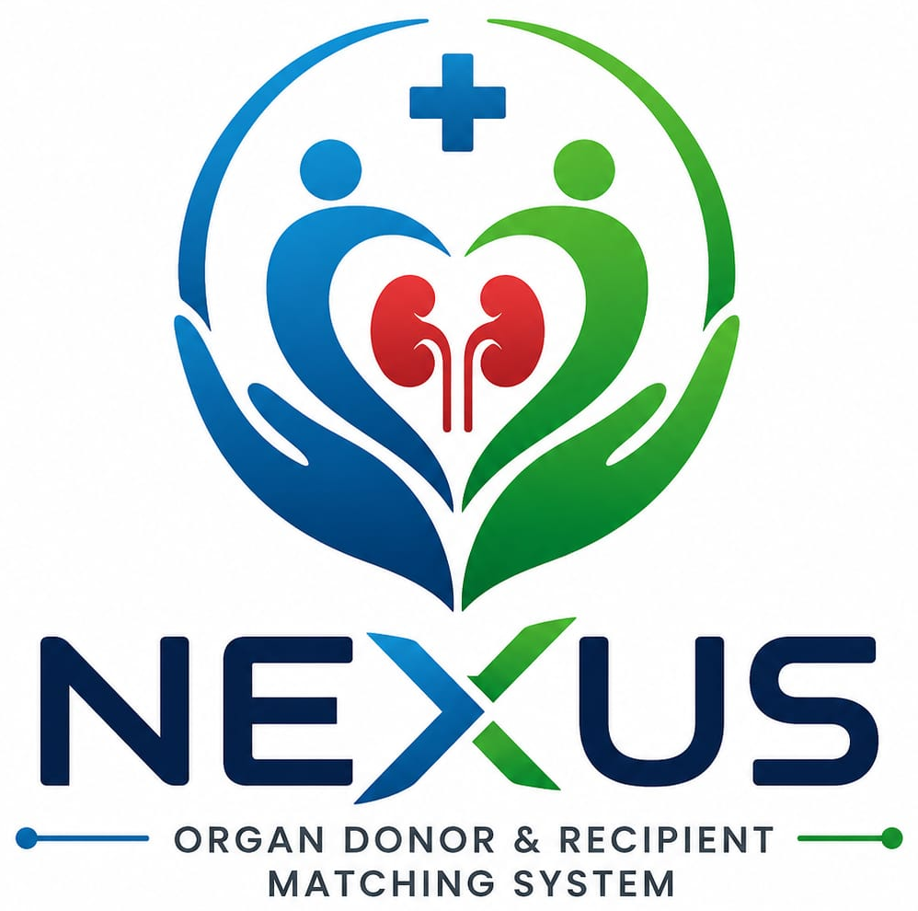
NEXUS
ORGAN DONOR & RECIPIENT MATCHING SYSTEM
A web-based platform connecting donors, recipients, and hospitals — bringing speed, transparency, and trust to organ matching.
Mini Project | Computer Science & Business Systems (CSBS) | 2nd Year

Slide 2




The Problem
Why organ matching needs a better system
Lives lost waiting
Manual record-keeping
Many patients die every year before a matching organ is found in time.
Donor and recipient data is scattered across paper files and disconnected systems.
Slow matching process
No centralized visibility
Searching for compatible donors by hand takes precious time in an emergency.
Hospitals lack a single, transparent platform to verify and track transplant cases.
Goal: replace this slow, manual process with a fast, digital, transparent matching system.
NEXUS | Organ Donor & Recipient Matching System
2

Slide 3





Our Solution & Objectives
Key Objectives
What NEXUS Does
Build a secure digital database of donors and recipients
NEXUS is a web application that connects donors, recipients, hospitals, and administrators on one platform. Donors register the organs they wish to donate; recipients or hospitals register patient needs. The system automatically finds compatible matches and alerts the hospital for medical verification — cutting search time and improving transparency.
Automatically match donors and recipients on compatibility
Reduce the time required to find a suitable organ
Donors
Recipients
Hospitals
Admin
Improve transparency and accuracy across the process
One connected network, matching in real time.
Help hospitals manage organ donation efficiently
NEXUS | Organ Donor & Recipient Matching System
3

Slide 4







System Modules
Seven modules working together as one platform
User Registration
Donor
Recipient
Matching
Sign-up & secure login for all roles
Register organs & donation preferences
Request organs & track status
Auto-match by group, organ & location
All modules connect through one shared database — keeping every role in sync.
Hospital
Admin
Notification
Verify records & approve transplants
Manage users & generate reports
Alert hospitals, donors & recipients
NEXUS | Organ Donor & Recipient Matching System
4

Slide 5






System Workflow
From registration to a completed, verified transplant
Recipient Requests
Hospital Verifies
Status Updated
Patient requests a required organ
Medical team confirms the match
Record updated for all parties
1
2
3
4
5
6
Donor Registers
System Checks Match
Transplant Initiated
Donor signs up with organ details
Compatibility engine finds candidates
Approved case moves to procedure
Every step is logged — giving donors, recipients, and hospitals full visibility into the process.
NEXUS | Organ Donor & Recipient Matching System
5

Slide 6





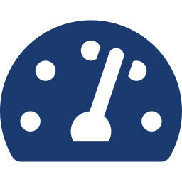





Key Features & Technology
Key Features
Technology Stack
Secure registration & login
Organ search & auto-matching
HTML
CSS
JavaScript
Real-time notifications
Admin dashboard & reports
PHP
MySQL
VS Code / XAMPP
Hospital verification workflow
End-to-end status tracking
• Intel i3 processor or above
• 4 GB RAM or more
• 20 GB free storage
• Stable internet connection
NEXUS | Organ Donor & Recipient Matching System
6

Slide 7






Advantages & Future Scope
Advantages
Future Scope
Saves lives by reducing matching time
AI-based compatibility prediction
Fast, accurate donor-recipient matching
Dedicated mobile application
Reduces manual paperwork
Integration with government health portals
Easy to manage donor records
SMS and email notifications
Secure and transparent system
GPS-based nearest hospital search
Useful for hospitals and patients alike
NEXUS | Organ Donor & Recipient Matching System
7

Slide 8
How NEXUS is Different
Organ matching is a different challenge from blood donor matching
Blood Donor Finder
NEXUS (Organ Matching)
What it matches
Blood donors
Organ donors & recipients
Donation frequency
Can donate multiple times
Mostly a one-time donation
Matching basis
Blood group only
Blood group, organ type, medical fit & location
Verification
Minimal
Full hospital verification
Used for
Blood emergencies
Organ transplantation
NEXUS brings the speed of digital matching to the life-or-death task of organ transplantation.
NEXUS | Organ Donor & Recipient Matching System
8

